Slide 1
Staying in School
Christa Colvin
CRE 101 Section 29484
9 December 2011

Slide 2
Introduction
The service question this year for students at Mesa Community College is how can we keep students in school when they receive a blow in their life. The way that I researched this question was by studying information on teen pregnancy and how that correlates with going to school.

Slide 3
Personal Story
There have been moments in my life when I just want to give up and stop what I’m doing just because I can not take the stress any longer. I have never experienced that feeling more than ever than this school semester. I am a part time worker and work at least 20-25 hours a week and I am also taking 13 credit hours. The classes that I am taking this semester include anatomy, introduction to nursing and healthcare systems, abnormal psychology, and critical reading. I have definitely been staying very busy this semester with doing homework, studying for tests, and working all of which are really great things but I must say it can be extremely stressful. I know there were sometimes during this semester when I would have several tests all in the same week and of course my work schedule would be hectic as well and I would just want to give up because of the stress.

Slide 4
Personal Story…
When I would get stressed out and want to quit I would stop and think to myself I need to keep going and I’ll get through this. I would also keep telling myself you have to keep going so you can better yourself, have a great education, and job.
It is now the end of the semester and I feel that the struggles have definitely been worth it and that all my hard work is paying off.

Slide 5
Project HOPE
My Project HOPE consisted of statistics, campaign ads, cartoons, photographs, speeches, editorials, and information about teen pregnancy and schools.
All of the media that I included should young girls who were/had been pregnant or how becoming pregnant effects getting an education.

Slide 6
Project HOPE: Statistics
The statistics that I researched for my project HOPE included statistics about teen pregnancy. I also researched statistics about how teen pregnancy effects an education.

Slide 7
Project HOPE: Statistics
Some of the statistics that I researched were:
“Teen mothers are less likely to complete high school, only one-third receive a high school diploma” (Teen Pregnancy Stats, Facts, and Prevention).
“Every year around 750,000 teenagers will get pregnant” (Teen Pregnancy Statistics ).
“More than 2/3 of all teenagers who have had a baby will not graduate from high school” (Teen Pregnancy Statistics).
“Thirty-four percent of young women become pregnant at least once before they reach the age of 20” (Teen Pregnancy Stats, Facts, and Prevention).
“Only 1.5% have a college degree by age 30” (Teen Pregnancy Stats, Facts, and Prevention).

Slide 8
Analysis of Project HOPE Statistics
The analysis that I was able to make based off of the statistics that I researched about teen pregnancy and education supported that “teen mothers are less likely to graduate high school…receive a high school diploma” (Teen Pregnancy Stats, Facts, and Prevention).
The one statistic that surprised me when I first read it was “only 1.5% have a college degree by age 30” (Teen Pregnancy Stats, Facts, and Prevention).
That statistics is extremely low from what I thought it would be. As I sat and thought more about this statistic I realized that it must be accurate simply because if a teenage girl has a baby in high school and does not graduate then she can not expand her education until she does receive her diploma.

Slide 9
Project HOPE: Teen Pregnancy and Education
On one website that I looked at it stated two ways how teen pregnancy and education correlate.
“Students who participate, get good grades, don’t have a lot of absences, and plan to go to college have a tendency to not become pregnant”(Why It Matters Teen Pregnancy and Education).
“Students who don’t participate, get bad grades, are absent continuously, and don’t plan on going to college have a tendency to become pregnant”(Why It Matters Teen Pregnancy and Education).
These two quotations seem to be common sense observations/assumptions a person may make which I found very interesting.

Slide 10
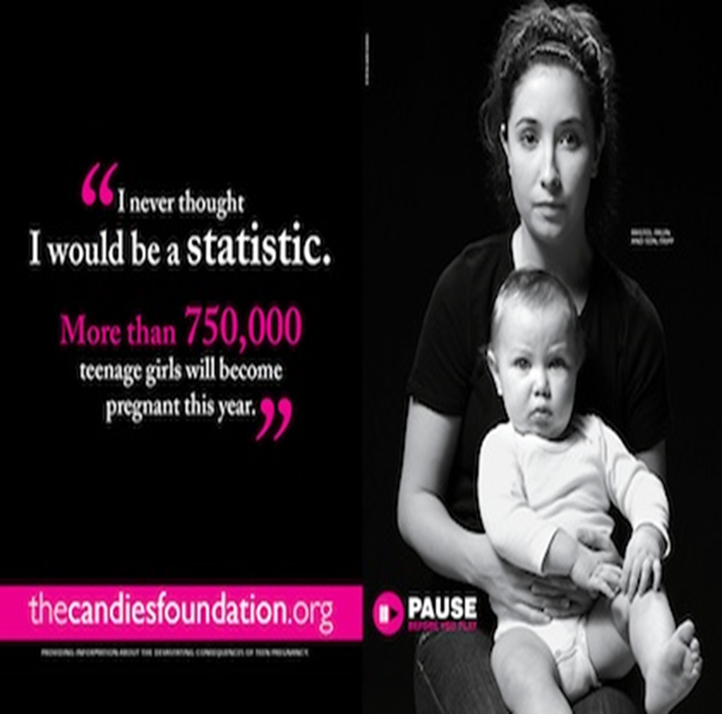
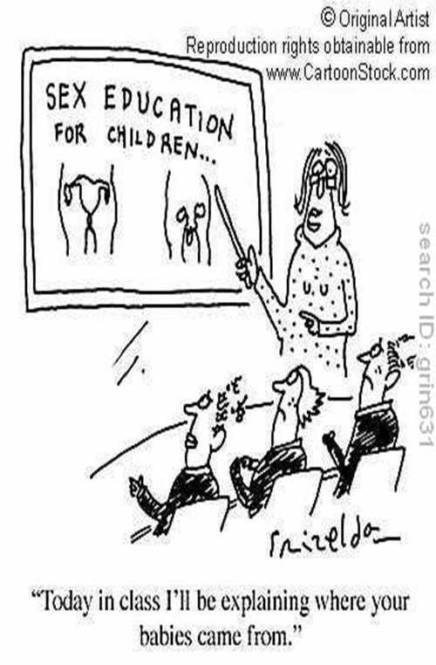
Project HOPE: Campaign Ad and Cartoon

Slide 11
Project HOPE: Campaign Ad, Cartoons, and Photograph
The campaign ad, cartoon, and photograph that I included in my Project HOPE are all great representations girls who are pregnant and who have been pregnant. The campaign ad is showing Bristol Palin (teen mother) with her son Tripp and there are statistics describing how many girls will get pregnant each year (Pause Before You Play). The cartoon that I included in my Project HOPE shows a teacher who is teaching sex education to a class. The caption that is under the cartoon says “today in class I will be teaching you where your babies come from” (Grizelda). From the caption a reader can make the inference that the children have already had sex and are facing the consequence but never had sex education to learn about sex and the consequences.

Slide 12

Project HOPE: Photograph

Slide 13
Project HOPE: Photograph
The photograph that I chose for my Project HOPE shows a young girl looking at a pregnancy test with a shocked expression on her face (Google Images). The expression on the girl’s face leave the viewer the idea that the girl must be pregnant.

Slide 14
Project HOPE: Speech
The speech that I chose to analyze for my Project HOPE was one of the best speeches I have ever heard. The mom who was giving the speech is a teen mother herself who has experienced just how difficult it can be to have a child when a person is so young. The woman begins her speech by discussing facts/statistics with her viewers and then discusses the options that girls have if they do become pregnant. Once, she presents this information she tells her viewers her story which adds a whole new perspective to the information she is presenting (The Best Teen Pregnancy Speech Ever!!!).

Slide 15
Project Hope: Editorial
The editorial that I included in my Project HOPE describes how becoming a teen mother can bring challenges but also heartache. The author discusses how if the mother does not complete her high school she won’t be able to have a good job which will cause financial problems and heartache (Teenage Pregnancy Blights Too Many Lives).

Slide 16
Project HOPE: Alternative School
Laurie Rappeport suggests that alternative schools are a great choice for teenage mothers because:
Peer and Staff Support “The peers at alternative schools face similar or the same problems as one another which can help them cope…the staff at these schools are specialized or trained to help these students succeed” (Alternative High Schools for Young Teen Mothers ).
Child Care “Alternative schools often provide child care so the mothers can focus on the school work and don’t have to worry about finding a day care or babysitter while they are at school” (Alternative High Schools for Young Teen Mothers).
Flexibility with School Work “Alternative school teachers are flexible with the students assignment due dates since students might miss school due to a medical issue, their child being ill, etc” (Alternative High Schools for Young Teen Mothers).
Vocational and Parenting Skills “The schools also provide vocational programs so the moms can learn occupational skills as well as finish high school… alternative schools also provide parenting classes so the young moms can learn positive parenting behaviors” (Alternative High Schools for Young Teen Mothers).

Slide 17
Project HOPE: Alternative School
Even if teen mothers can not graduate from a regular high school they can transfer to an alternative high school. Alternative high schools would be a wise choice for a teen mother because they have “the support of the staff/students, child care, flexibility with school work, and vocational/parenting skills for their students (Rappeport, 2011). Alternative schools will provide teen mothers a high school education and vocational skills so they can have a decent job (Rappeport, 2011).. The mothers can also see their children at the daycare at the school and don’t have to worry about finding a babysitter (Rappeport, 2011).

Slide 18
Conclusion
In all, from studying teen pregnancy and learning about the options that are out there for teenagers who become pregnant, it goes to show that even though a person who may get some bad luck still have options to help them stay in school.

Slide 19
References
Google Images. Google. Web. 25 Nov. 2011. <http://www.google.com/search?tbm=isch&hl=en&source=hp&biw=1024&bih=627&q=teen+pregnancy&gbv=2&oq=teen+pregnancy&aq=f&aqi=&aql=&gs_sm=e&gs_upl=1726l7539l0l7811l20l20l3l14l17l0l182l452l0.3l3l0>.
“Grizelda. "Teen Pregnancy Cartoons and Comics." CartoonStock - Cartoon Pictures, Political Cartoons, Animations. CartoonStock. Web. 04 Nov. 2011. <http://www.cartoonstock.com/directory/t/teen_pregnancy.asp>.
Pause Before You Play | Teen Pregnancy Campaign Message | the Candie's Foundation." Raising Awareness About Teen Pregnancy | the Candie's Foundation. The Candie's Foundation, 2011. Web. 02 Nov. 2011. <http://www.candiesfoundation.org/campaigns.html>.
Rappeport, Laurie. "Alternative High Schools for Young Teen Mothers | EHow.com." EHow | How to Videos, Articles & More - Discover the Expert in You. | EHow.com. 24 Feb. 2011. Web. 03 Nov. 2011. <http://www.ehow.com/info_7974714_alternative-schools-young-teen-mothers.html>.
""Teenage Pregnancy Blights Too Many Lives - Editorials - Charleston Daily Mail - West Virginia News and Sports." - - Charleston Daily Mail - West Virginia News and Sports -. Charleston Daily Mail, 20 Oct. 2011. Web. 26 Nov. 2011. <http://dailymail.com/Opinion/Editorials/201110190140>.
"Teen Pregnancy Statistics - Pregnant Teen Help." Pregnant Teen Help - Teen Pregnancy Statistics, Prevention, and Facts. Pregnant Teen Help. 23 Nov. 2010. Web. 02 Nov. 2011. <http://www.pregnantteenhelp.org/statistics/teen-pregnancy-statistics/>.

Slide 20
References
"Teen Pregnancy Statistics, Signs, Facts :Teenage Pregnancy Prevention." Troubled Teen Help Military Boarding Schools. Family First Aid, 2004. Web. 02 Nov. 2011. <http://www.familyfirstaid.org/teen-pregnancy.html>.
"The Best Teen Pregnancy Speech EVER!!! - YouTube." YouTube - Broadcast Yourself. Web. 26 Nov. 2011. <http://www.youtube.com/watch?v=Uf-C1nFkqpU>.

